Slide 1
CHAPTER 5 Predictive Control with constraints 9 Dual-mode approaches
Anthony Rossiter

Slide 2
Background
The previous video demonstrated the principle of how constraints can be tested over an infinite horizon using a finite number of inequalities.
This can be achieved using maximal admissible sets where the asymptotic value is strictly inside the constraints.
The existence of an asymptotic value implicitly means the transition matrix has stable eigenvalues. [We do not care to consider subtle issues linked to poles on the unit circle.]
The next challenge is to apply this theory to OMPC/SOMPC algorithms.

Slide 3
Maximal admissible set
What set of inequalities will ensure that for the model:
Then the following constraints will be satisfied for all k.
Given that:

Slide 4
Maximal admissible set
Let the inequalities be given for a specified horizon ‘n’:
Try and find a value ‘x’ which violates constraints at ‘n+1’ but satisfies constraints earlier on.
If we cannot force a violation, then ‘n’ is large enough.
If we can, increase n and try again.

Slide 5
Objectives
FOR OMPC/SOMPC:
Express predictions in the form:
Express sample constraints in the form:
After which result is automatic using standard MAS iterations.

Slide 6
Autonomous model formulation
A convenient mechanism for handling the two modes in the prediction is to form an augmented model where the perturbation terms are treated as extra states – this way one can reduce the model format to a single mode which is thus amenable to standard results and formulae.

Slide 7
Typical constraints
Limits on an input:
Limits on states:
Input rates are not available directly from the model given here. If these are needed, the model must be augmented with the relevant state to define these.

Slide 8
Combined constraints
Combining the 3 sets of inequalities from the previous pages gives:
Clearly one can add other constraints as required.

Slide 9
Constraint handling with dual mode predictions
The model takes the form:
Constraints at each sample can be re-arranged into the form:
Clearly this is an identical format to the generic result given in the previous video.
The corresponding sets are called MCAS because they include the d.o.f. within c_{k} as well as the initial state.

Slide 10
Maximal controlled admissible set
It may be convenient to express, the MCAS differently. Given:
This can be expanded to:
Or:
To a limit, the more columns in N, the larger S_{MCAS}.

Slide 11
MATLAB code
Only a few examples are given here as this SOMPC algorithm does not include non-zero targets.
The idea will be simply to demonstrate that the inequalities defining the MCAS can be constructed.
Viewers should note that plotting the regions is none trivial as it requires set projection for which a toolbox such as the MPQP (from ETH) one would be advised.
KEY EXAMPLES ARE IN video5_9_example1.m and video5_9_example2.m
MAIN CODE is chap5_ompc_simulate_constraints.m
In OMPC folder.

Slide 12
video5_9_example1.m
Constraints active for one sample, otherwise QP returns optimal c as zero.

Slide 13
video5_9_example2.m
Constrained and unconstrained clearly different.
c(k) clearly non-zero during transients.
Sketch of unconstrained simulations clearly violates state constraints as well as input constraints.

Slide 14
MCAS
MAS
Used mpt3 toolbox from ETH to plot the MCAS sets.
http://control.ee.ethz.ch/~mpt/3/Geometry/Sets

Slide 15
Summary
This video has shown how an invariant set or MCAS can be constructed for the OMPC/SOMPC algorithm.
This set ensures the predictions satisfy constraints over an infinite horizon using a finite number of inequalities.
Simulations of OMPC using a regulation problem demonstrate the algorithm works.
The cost is still Lyapunov as expected.
The values for c have a strong pattern consistent with the well posed problem structure.

Slide 16



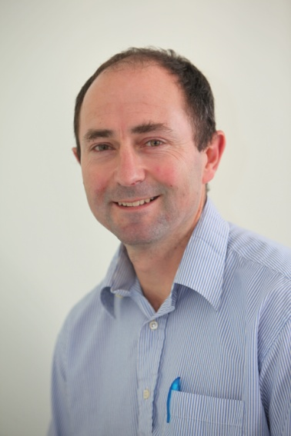
Anthony Rossiter
Department of Automatic Control and Systems Engineering
University of Sheffield
www.shef.ac.uk/acse
© 2014 University of Sheffield
This work is licensed under the Creative Commons Attribution 2.0 UK: England & Wales Licence. To view a copy of this licence, visit http://creativecommons.org/licenses/by/2.0/uk/ or send a letter to: Creative Commons, 171 Second Street, Suite 300, San Francisco, California 94105, USA.
It should be noted that some of the materials contained within this resource are subject to third party rights and any copyright notices must remain with these materials in the event of reuse or repurposing.
If there are third party images within the resource please do not remove or alter any of the copyright notices or website details shown below the image.
(Please list details of the third party rights contained within this work.
If you include your institutions logo on the cover please include reference to the fact that it is a trade mark and all copyright in that image is reserved.)

